Slide 1

CSE 351
Presentation
Nov.30.25
Movie Revenue Prediction
Hochan Jun Woochul Lim

Slide 2
Agenda
CSE 351 Presentation
Our Goal
1.
2.
Preprocessing & EDA
Used Models
3.
Simple Linear regression
Multiple Linear regression
Polynomial (Ridge) regression
4.
Drawing a Conclusion

Slide 3
CSE 351 Presentation
Our Goal
1. Derive 4 insights from the raw data
Patterns observed from movie release dates
Movie genre trend shifting patterns
Strongest and weakest features correlated with movie revenue
Revenue of movies relative to their budget
2. Predict the revenue of 2010’s movies
70% training set & 30% testing set

Slide 4
Preprocessing
CSE 351 Presentation
1. Eliminated null, NaN from all columns
2. Dropped all zero values:
budget, popularity, revenue, runtime, vote_count
3. Dropped out of range values in terms of voting rate:
vote_average
4. Extracted text data from particular format (Series, Dict) columns:
production _countries, production_companies, genres

Slide 5
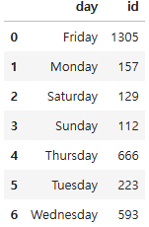
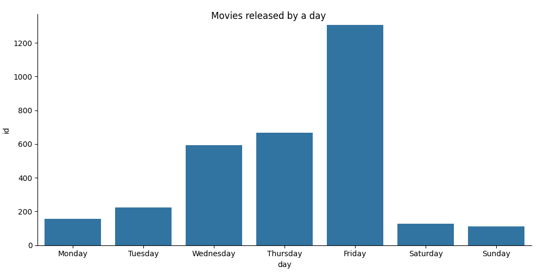
CSE 351 Presentation
EDA
1. Patterns observed from movie releases by day of week
Movies tend to be released more frequently as the week approaches Friday.
Movies are released the most on Friday, while the fewest movies are released on the weekend.
Notes:
우철
The first EDA problem is to analyze the number of movies released by day of week, month and, year.

Slide 6
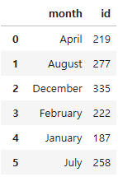
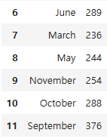
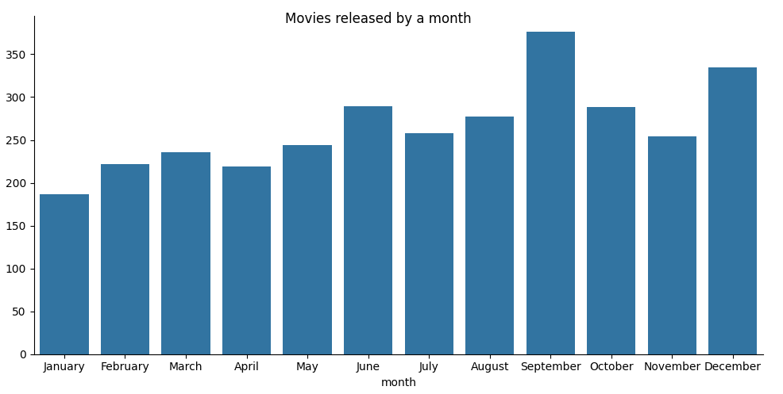
CSE 351 Presentation
EDA
1. Patterns observed from movie releases
by month.
Movies are released the most on September, and the fewest movies are released on November.
Movies tend to be released more frequently as the year moves toward its end.
Notes:
우철

Slide 7
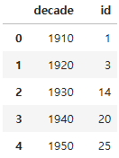
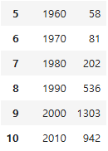
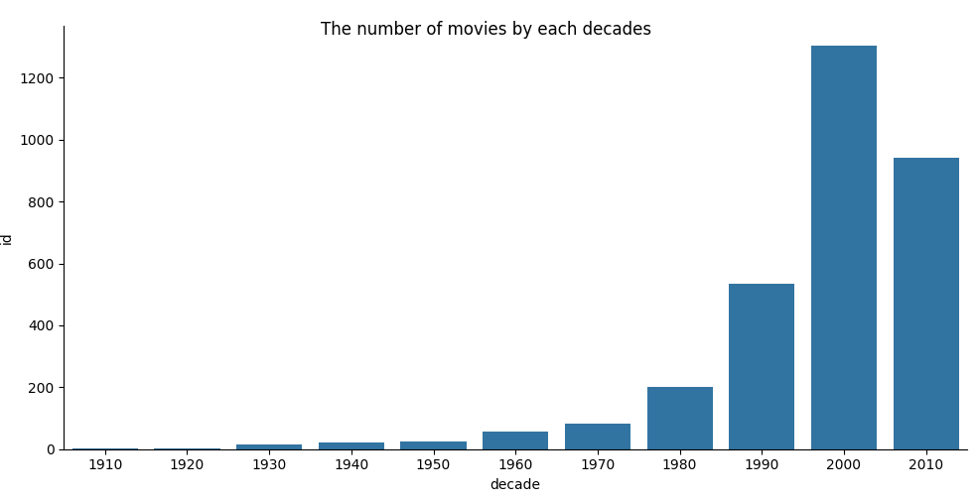
CSE 351 Presentation
EDA
1. Patterns observed from movie releases
by year
As the time passes yearly, the movie market size increases exponentially.
The latest movie in the data was of 2017, so the data in 2010s would be likely lower than the actual total number because the it does not include the full decade.
Notes:
우철
We can we the increased number of movies releases as the time passes. It might be because of the growth in the movie market size.
You can see a drop of the number of movie releases from 2000 to 2010.
This is because the most recent movie in the data was released in 2017, so the data doesn’t reflect the actual number of movies released in 2010s.

Slide 8
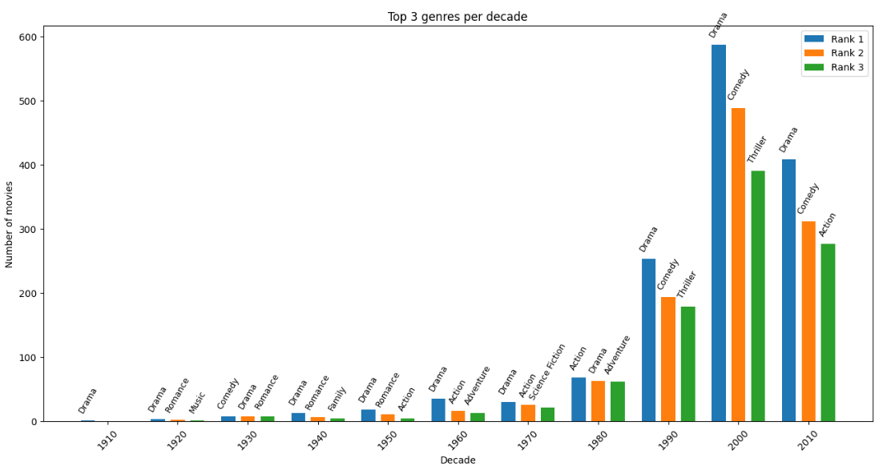
CSE 351 Presentation
EDA
2. Movie genre trend shifting patterns
We ranked top 3 genres from each decades.
The movie market was the most active in 2000's than any other decades.
Drama was one of the most popular genres across all time periods.

Slide 9
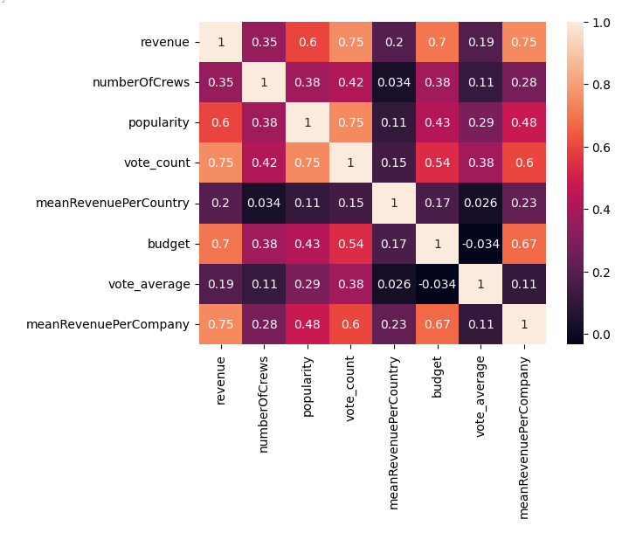
CSE 351 Presentation
EDA
3. Features correlated with revenue
Strong correlations with revenue:
vote_count
budget
mean revenue per prod. company
popularity
Weak correlations with revenue:
vote_average
mean revenue per country
Notes:
우철
In this heatmap, we can examine the correlation between revenue and other features.
We can analyze which features are strongly and weakly correlated.
Vote count and the average revenue per company have a strongest correlation with revenue.
And the budget comes the second, popularity comes the third.
Feature that has

Slide 10
CSE 351 Presentation
EDA
4. All time ROI ranking (Revenue / budget)
title | year | genre | Revenue ($) | Budget ($) | ROI ratio
Modern Times | 1936 | Drama, Comedy | 8.5M | 1 | 8,500,000
Nurse 3-D | 2013 | Horror, Thriller | 10M | 10 | 1,000,000
Paranormal Activity | 2007 | Horror, Mystery | 193M | 218 | 12,890
Tarnation | 2003 | Documentary, Drama | 1.1M | 15,000 | 5,330
The Blair Witch Project | 1999 | Horror, Mystery | 248M | 60,000 | 4,133
Eraserhead | 1977 | Drama, Fantasy, Horror, SF | 7M | 10,000 | 700
Pink Flamingos | 1972 | Horror, Comedy, Crime | 6M | 12,000 | 500
Super Size Me | 2004 | Documentary, Comedy, Drama | 28M | 65,000 | 440

Slide 11
CSE 351 Presentation
EDA
4. All time ROI ranking (Revenue / budget)
In ranking Top 10, there were data errors as we learned from the lecture slides. When you see the budget column, there are some values that seems to be nonsense, such as 1, 10, 218.
We searched those movie budgets on google by our own, and found out that they were $1M, $10M, and $218 each. Surprising thing was that the movie Tarnation was actually one of the famous low-budget made movies ($218).
However, the Modern Times and Nurse 3-D can be concluded that this error likely originated from negligence on the part of the data entry personnel or the platform itself. The correct values should have been entered with consideration for the units, or the platform should have properly conducted unit conversion during the process of data refinement and management.

Slide 12
CSE 351 Presentation
Used Models
Simple Linear Regression
Simple Linear Regression models the linear relationship between a single independent variable (x) and a single dependent variable (y).
How it works: This regression finds the single best-fitting straight line that passes through the data points. The criterion for "best-fitting" is defined by the Ordinary Least Squares (OLS) method. OLS works by minimizing the sum of the squared differences (residuals) between the actual data points and the values predicted by the line. Therefore, the process mathematically determines the optimal slope and intercept.
Notes:
우철
Linear relationship - single independent variable - a single dependent variable
Single best-fitting straight line - Ordinary Least Squares (OLS) method.

Slide 13
CSE 351 Presentation
Used Models
Multiple Linear Regression
Multiple Linear Regression is an extension of Simple Linear Regression that uses two or more independent variables to predict a single dependent variable (y). Each independent variable has its own independent weight (coefficient).
How it works: This regression uses multiple variables to find the best-fitting hyperplane in a multi-dimensional space. It uses OLS algorithm to minimize prediction errors across all variables simultaneously, assigning an optimal weight to each input feature.
Notes:
우철
Two or more independent variables - a single dependent variable
Each independent variable has its own independent weight which will be coefficient of each variable.
Find the best-fitting hyperplane in a multi-dimensional space, meaning that it won’t be able to visualize if it exceeds third dimension.
OLS algorithm -> assign an the most optimum weight to each training variable

Slide 14
CSE 351 Presentation
Used Models
Polynomial (Ridge) Regression
Polynomial: It adds powers (exponents) of the independent variables as new features to the linear model. This allows the model to capture curved or non-linear patterns in the data that a simple straight line cannot fit.
Ridge: While polynomial regression increases model complexity, raising the risk of overfitting (performing well on training data but poorly on unseen data), Ridge Regression counteracts this by employing L2 Regularization, which simply means a more complex form of Ordinary Least Squares.
Notes:
우철
New features could be the square of one training variables, or multiplication of two or more training variables.

Slide 15
2 distributions of data
CSE 351 Presentation
70% - training set / 30% - testing set
Case 1
Case 2(Cross Validation)
Training set:
Data before 2010’s ( ~ 2009)
Testing set:
Data of 2010’s (2010 ~ )
Targeting:
Prediction of every revenue in 2010’s
Training set:
Randomly selected 70% from whole data
Testing set:
Rest 30% of whole data
Targeting:
Prediction of every revenue in randomly selected data
Notes:
호찬님

Slide 16
2 distributions of data
CSE 351 Presentation
Variables used in training & testing:
Log Budget
Popularity
Vote count
Number of Crews
Log Mean revenue per Country
Log Mean revenue per production company
* Budget was used as x-axis prediction because the RSE difference between models using budget and vote_count was minimal (around 0.0xx), suggesting similar predictive performance.
* Although vote_count has a higher correlation, budget still works well as it captures multiple underlying aspects of a film’s production.
* Log transformation was applied to both revenue and budget for scale reduction.
Variables used for visualization of results:
Log Budget (X-axis)
Log Revenue (Y-axis)
Notes:
호찬님

Slide 17
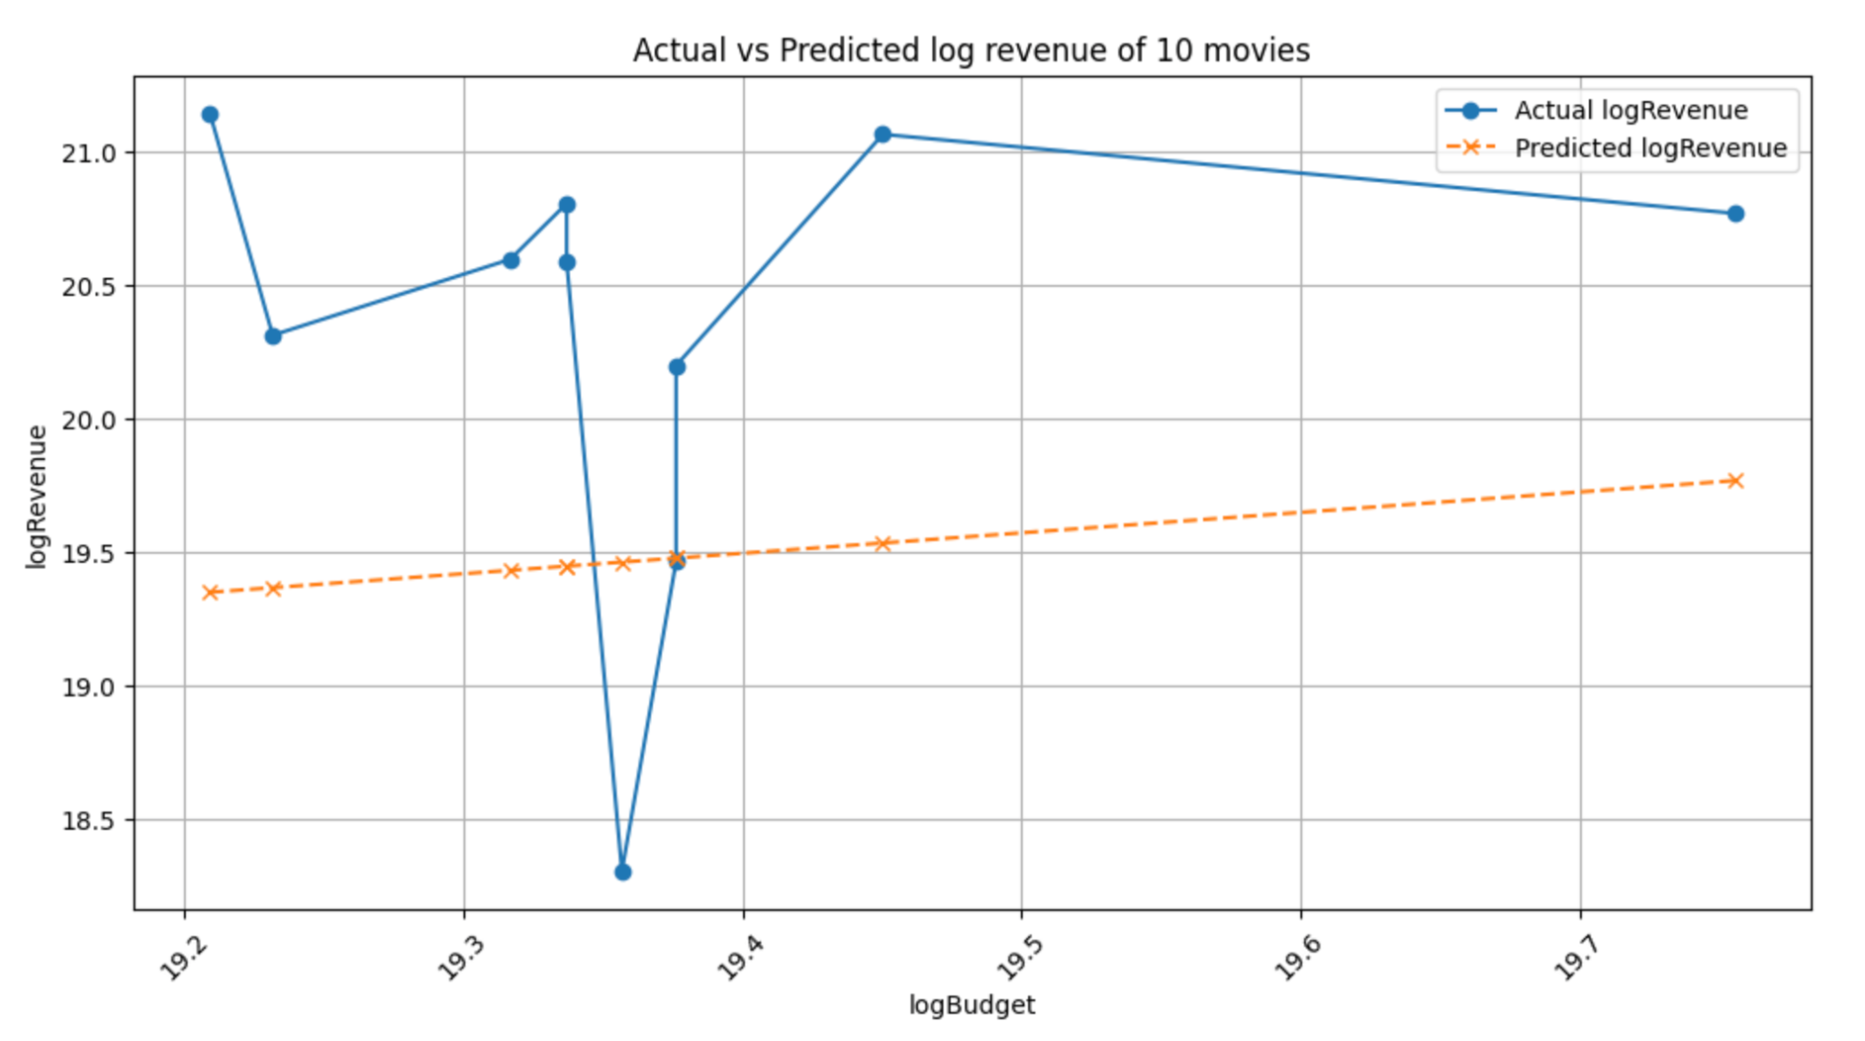
Simple Linear Regression
Used Models
CSE 351 Presentation
Case 1
RSE using the training data: 1.5531
RSE using the testing data: 1.5123
Since the model follows a linear form y = ax + b, it is visually clear that the predicted values differ noticeably from the actual values.
Revenue cannot be predicted accurately by only a single feature like budget.

Slide 18
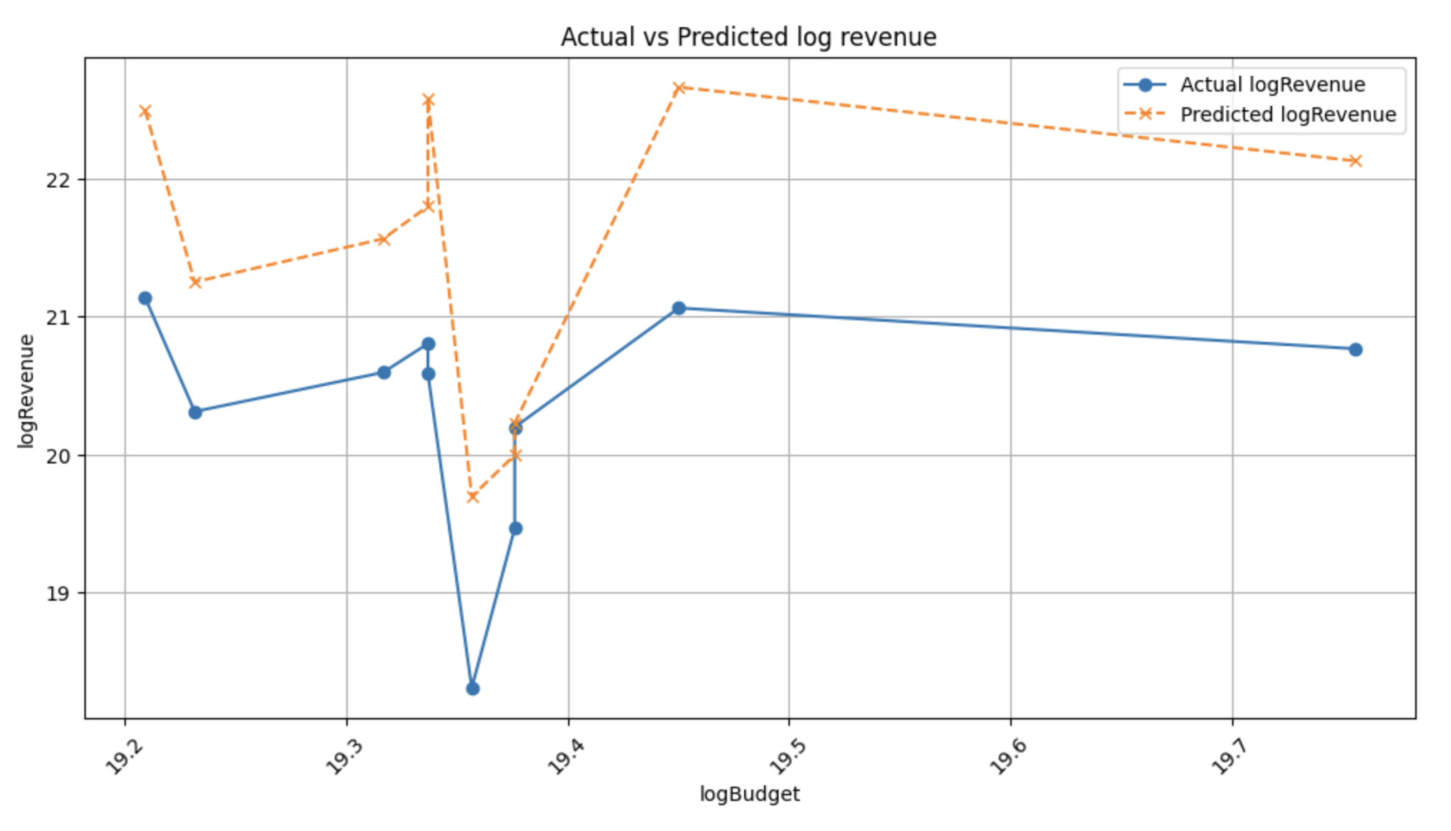
Multiple Linear Regression
Used Models
CSE 351 Presentation
Case 1
그래프 넣기
RSE using the training data: 1.1953
RSE using the testing data: 1.4588
The RSE of the testing data is higher than that of the training data.
This indicates that the movie industry changed after 2010, meaning that a model trained only on movies released before 2010 cannot fully capture the revenue patterns of movies released after 2010.

Slide 19
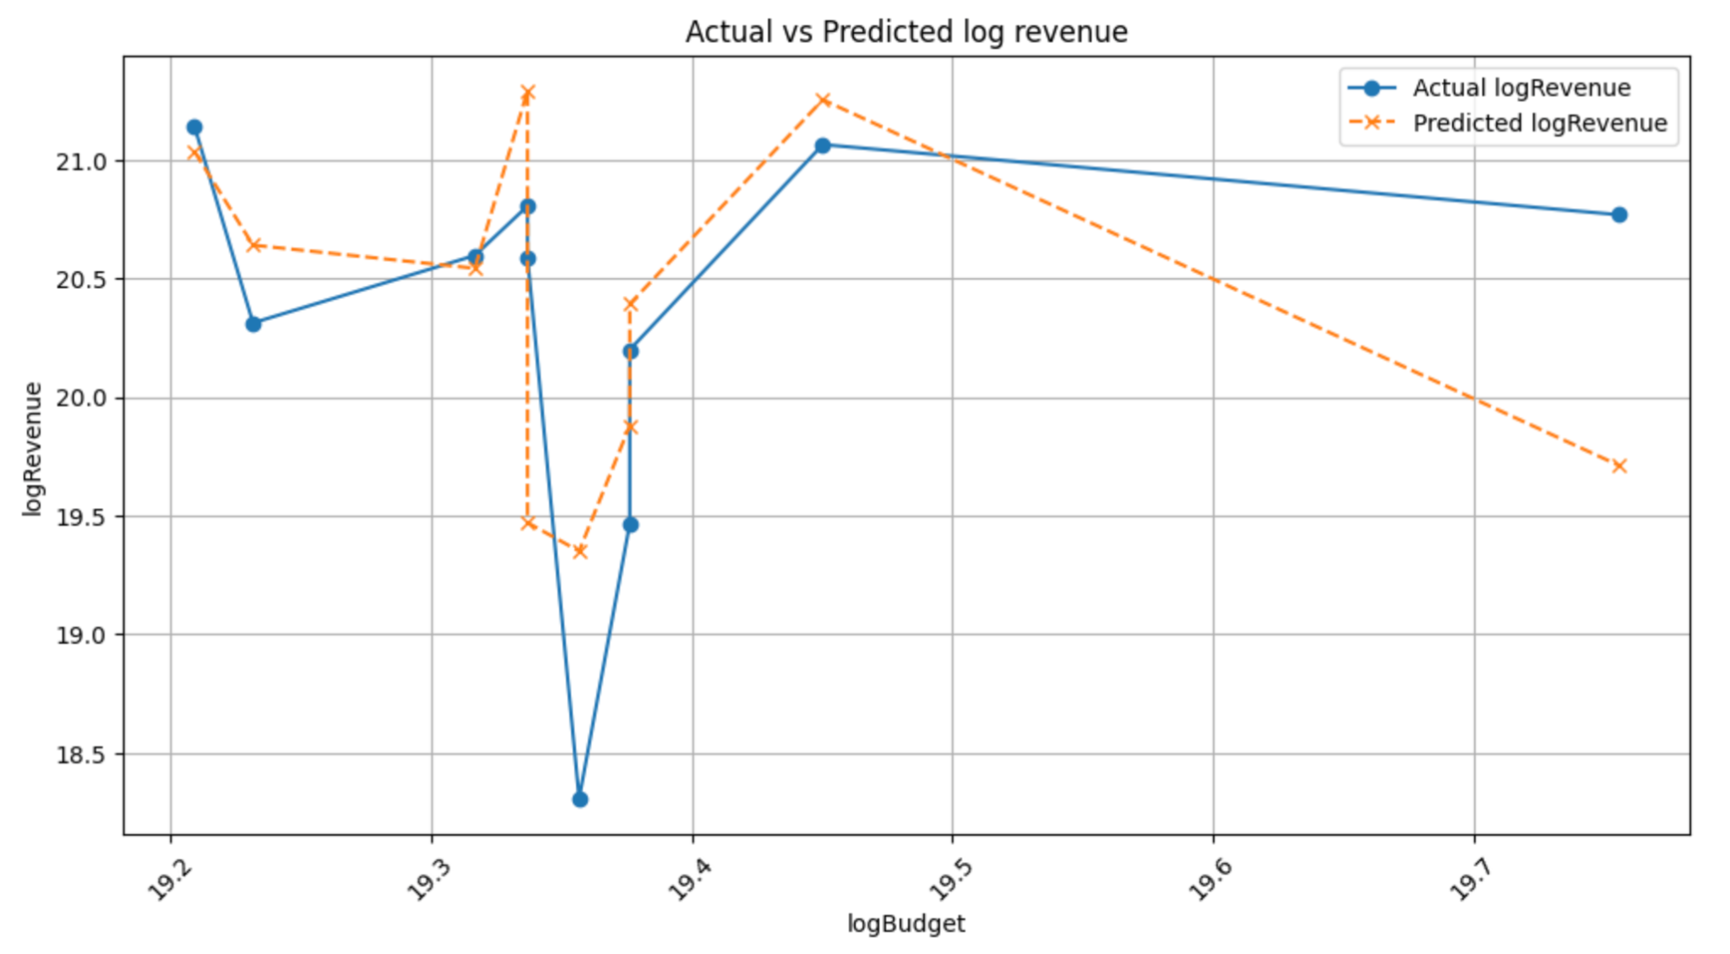
Polynomial (Ridge) Regression
Used Models
CSE 351 Presentation
Case 1
RSE using the training data: 1.0803
RSE using the testing data: 1.9158
The RSE of the testing data turned out to be higher than the RSE of the training data.
Similar to the results from multiple linear regression, the model does not capture the changed tendency of movies released after 2010.
The gap between the RSE of training and testing data becomes larger when compared to the RSEs from the multiple linear regression model.
This model is more complex, which increases the risk of overfitting, resulting in high variance on the testing data.

Slide 20
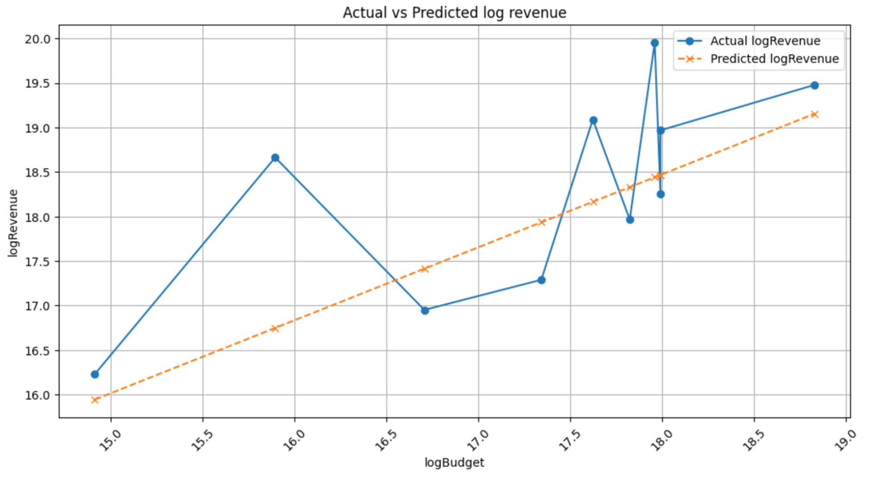
Simple Linear Regression
Used Models
CSE 351 Presentation
Case 2 (Cross Validation)
그래프 넣기
RSE using the training data: 1.5715
RSE using the testing data: 1.4723
The result is similar from the result of the simple linear regression model in Case 1.
Since this is a linear model, it is clear that the actual and expected revenue have noticeable gaps.
Notes:
우철

Slide 21
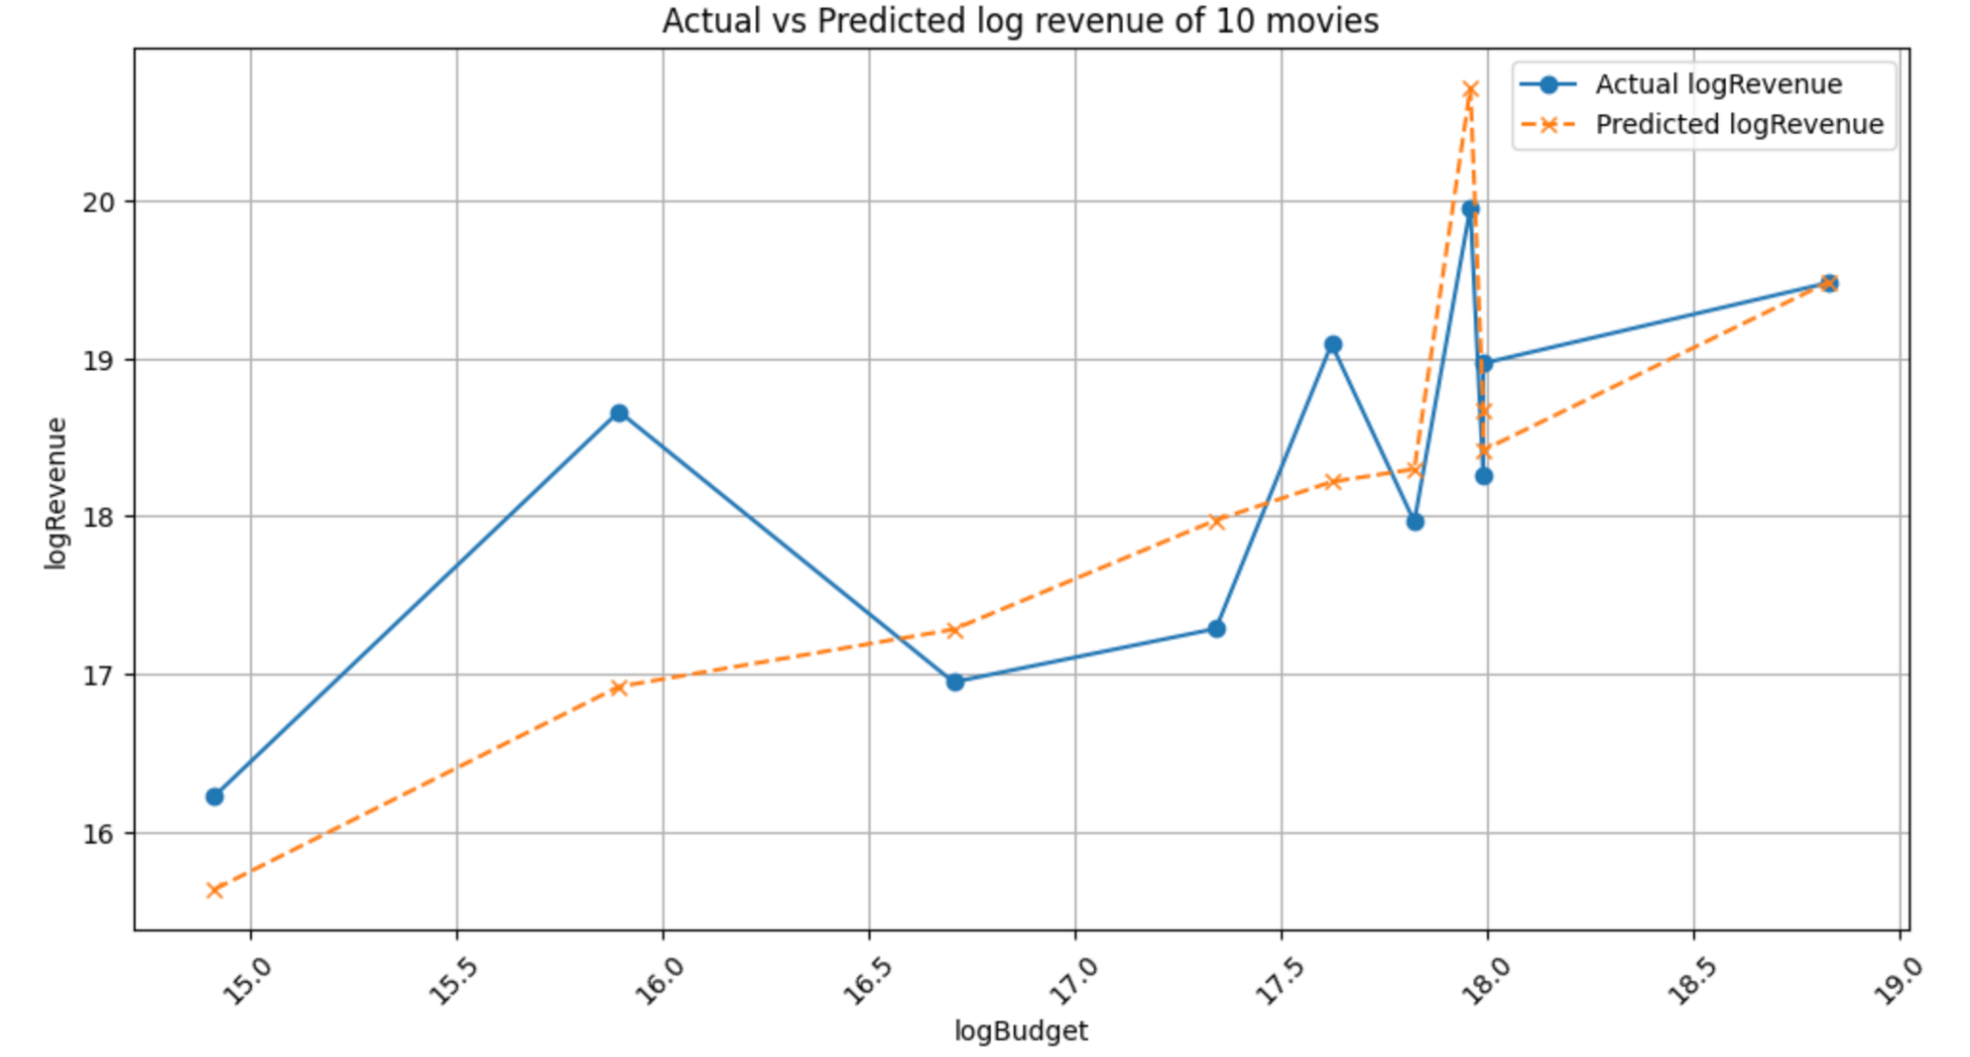
Multiple Linear Regression
Used Models
CSE 351 Presentation
Case 2 (Cross Validation)
그래프 넣기
RSE using the training data: 1.2195
RSE using the testing data: 1.1299
The RSE gap between the training and testing data becomes smaller in the random split when compared to Case 1.
Since the training and testing data are not biased toward any specific time period or other features in Case 2, it leads to more balanced and consistent RSE results.
Notes:
우철

Slide 22
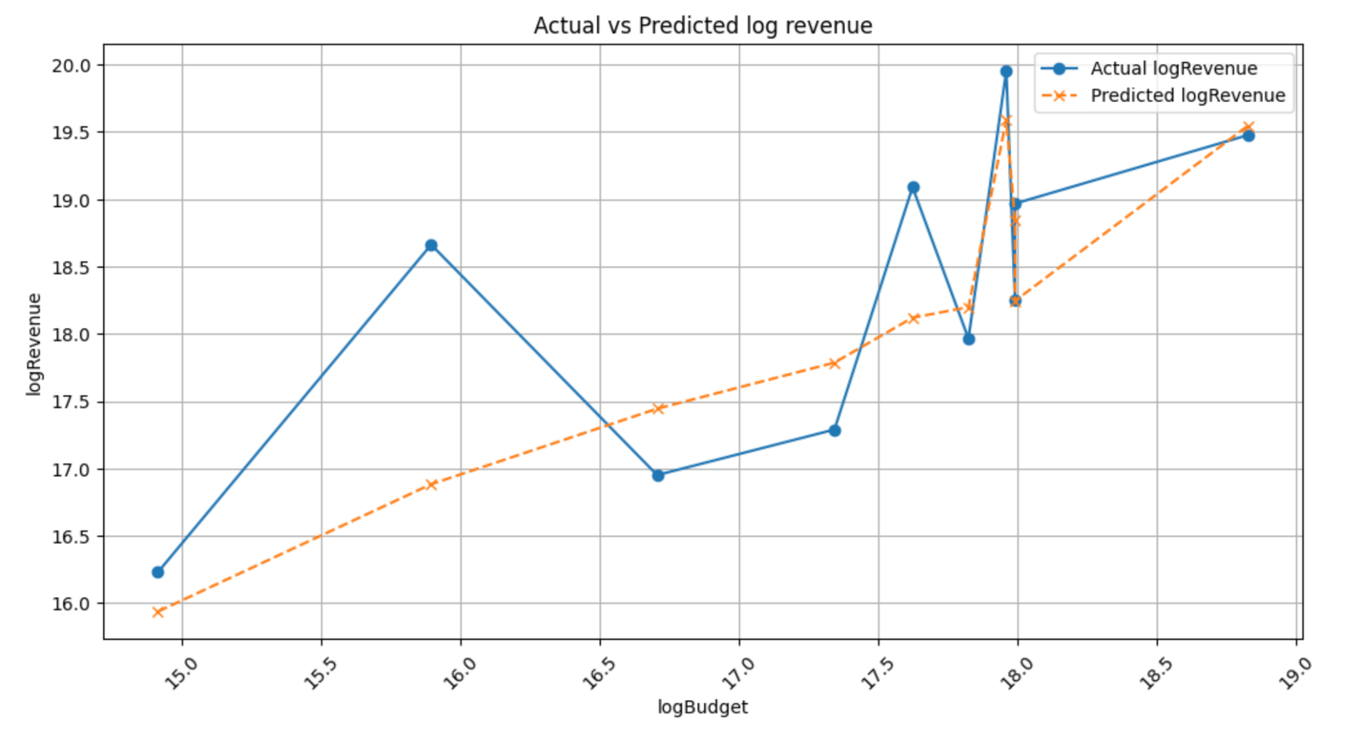
Polynomial (Ridge) Regression
Used Models
CSE 351 Presentation
Case 2 (Cross Validation)
RSE using the training data: 1.1206
RSE using the testing data: 1.1961
The RSE using polynomial regression is smaller than the RSE of linear regression when observing the training data, like Case 1
Conversely, the RSE using polynomial regression is higher than the RSE of linear regression when observing the testing data, like Case 1.
Notes:
우철

Slide 23
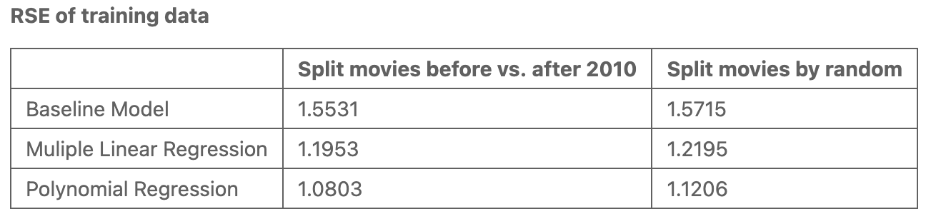
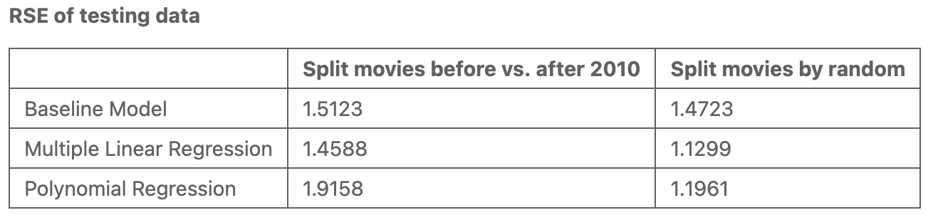
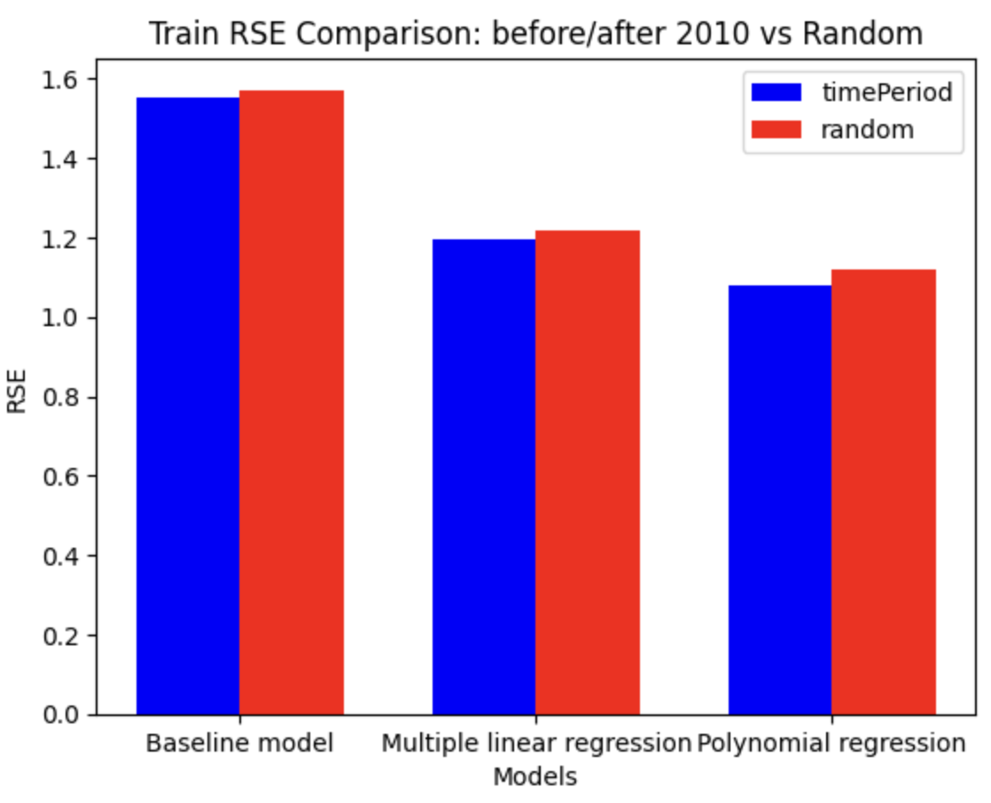
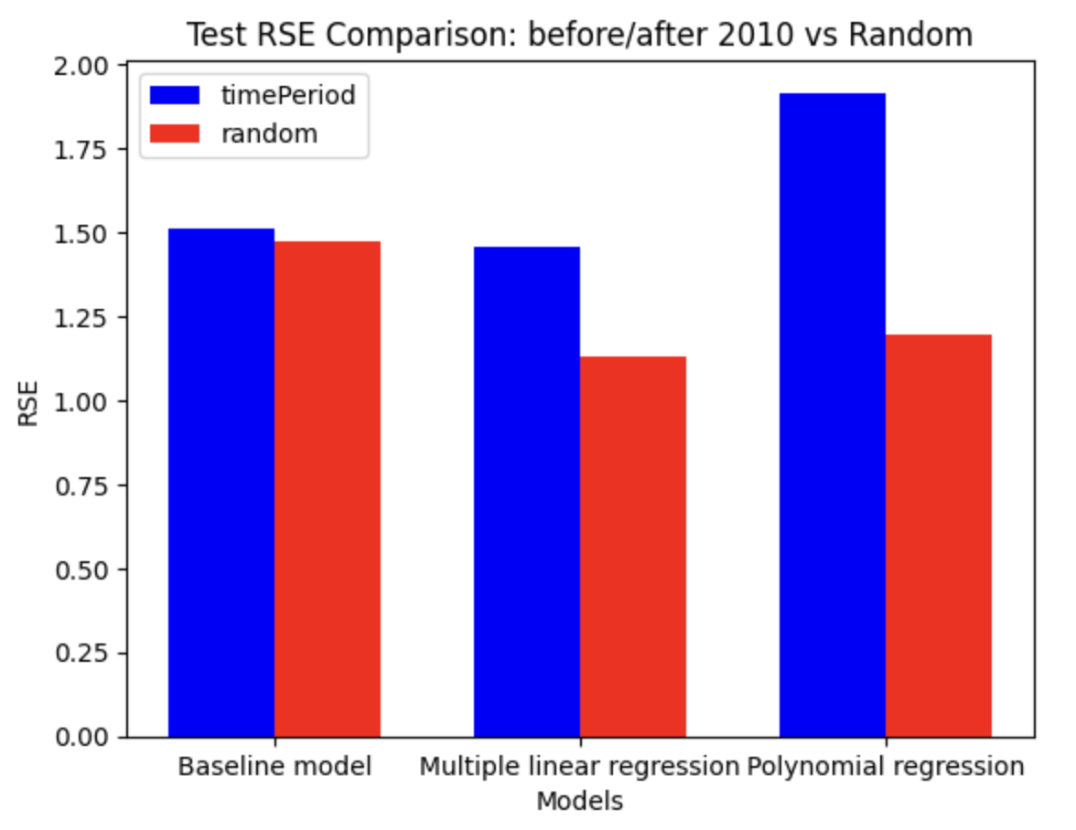
RSE Results
Notes:
우철
This is a whole summary of RSEs from testing and training data in two cases.
By looking at RSEs of the training data, as the models become complex, they give less error values.
However, testing data of the Case 1, which is data splitted by time period, gave the highest RSE.

Slide 24

Drawing
a Conclusion
Drawing a Conclusion
CSE 351 Presentation
In this part, our prediction result and the improvement of cross validation would be handled.

Slide 25
Final result
CSE 351 Presentation
1. Data splitting strategy significantly influences performance
Case 1:
When the data was divided by decades, the predicted curve followed a similar overall trend to the actual data, the predicted values were not close to the true values.
It failed to capture the changes in the scale of the film industry and the actual growth of the market over a certain amount of time. This indicates a limitation in analyzing the problem using only the given dataset.
Case 2:
On the other hand, the prediction using randomly split data was not affected by time, but was made only with the data itself. This derived a result having low RSE, though the tendency of case 1 seemed better than the one of case 2.
2. Multiple Linear regression record the lowest overall RSE
At first, we thought that the polynomial regression model would have make the best prediction since it does the most complicated calculations among the three models.
However it gave us a result worse than the multiple linear regression model because it was vulnerable to overfitting.
3. Future Improvement
In addition to movie data, time related information such as theater attendance numbers and Netflix subscriber counts would likely lead to more accurate results.
Applying a more stable feature normalization method is necessary to achieve more accurate results in polynomial regression.

Slide 26
Thank you

